Slide 1

Master’s Thesis Presentation Comparative Numerical Analysis of Free Field Acoustics using Finite and Boundary Element Methods Prashanth Setty Advisiors: Prof. Dr.-Ing. Julia Mergheim, LTM, FAU Oezge Akar, M. Sc., LTM, FAU Oliver Eichelhard, Dipl.-Ing, Woelfel

Slide 2
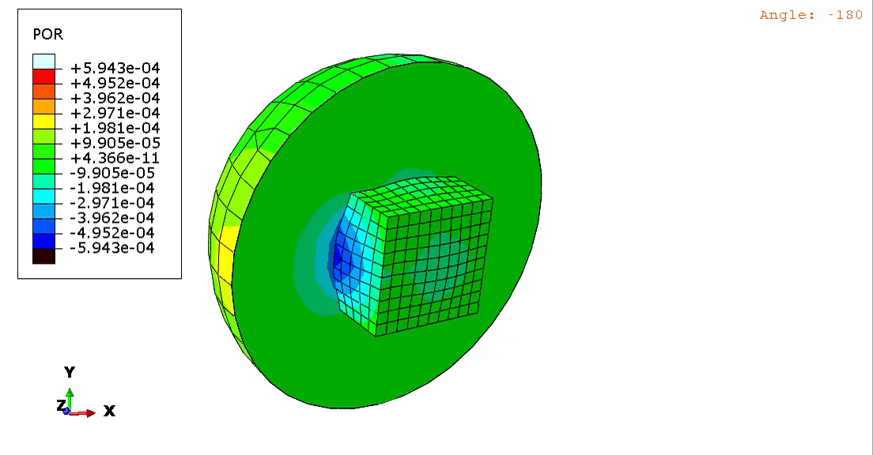
Introduction
Coupled Structural–Acoustic Analysis in a Nutshell:
Models the interaction between a vibrating structure and the surrounding fluid (e.g., air).
Predicts how structural vibrations generate sound and how acoustic pressure affects the structural vibrations.
Discretizes the structural and acoustic domains and couples them using interface elements.
Solves for structural displacements and acoustic pressures in a single simulation.
Free-Field Acoustics:
Represents an unbounded space without reflecting surfaces, like an open field.
Used to predict sound pressure levels at large distances from the source.

Slide 3
Motivation for Coupled Structural-Acoustic Analysis
Regulatory Compliance: Ensuring compliance with noise regulations and environmental guidelines.
The Ministry of Environment in Denmark mandates that noise emissions from wind turbines should not exceed 39 dB near residential areas.
Prototype Evaluation: Coupled Structural-Acoustic analysis enables early detection of structural defects by identifying deviations in resonant frequencies, amplitude levels, and sound pressure distributions, allowing for optimization before manufacturing.

Slide 4
Objectives
01
To compare fully and sequentially coupled structural–acoustic analysis in Abaqus for a prototype cube model, evaluating accuracy and computational efficiency.
02
To develop a sequential coupled simulation methodology for a wind turbine gearbox by integrating time-domain displacement data from Simpack into Abaqus.
03
To validate acoustic simulations in BEMPP (Boundary element method python package) by comparing sound pressure level predictions with Abaqus results for the prototype cube model.

Slide 5
Objective 1: Comparative Analysis of Fully Coupled and Sequentially Coupled Acoustic Simulations in Abaqus

Slide 6
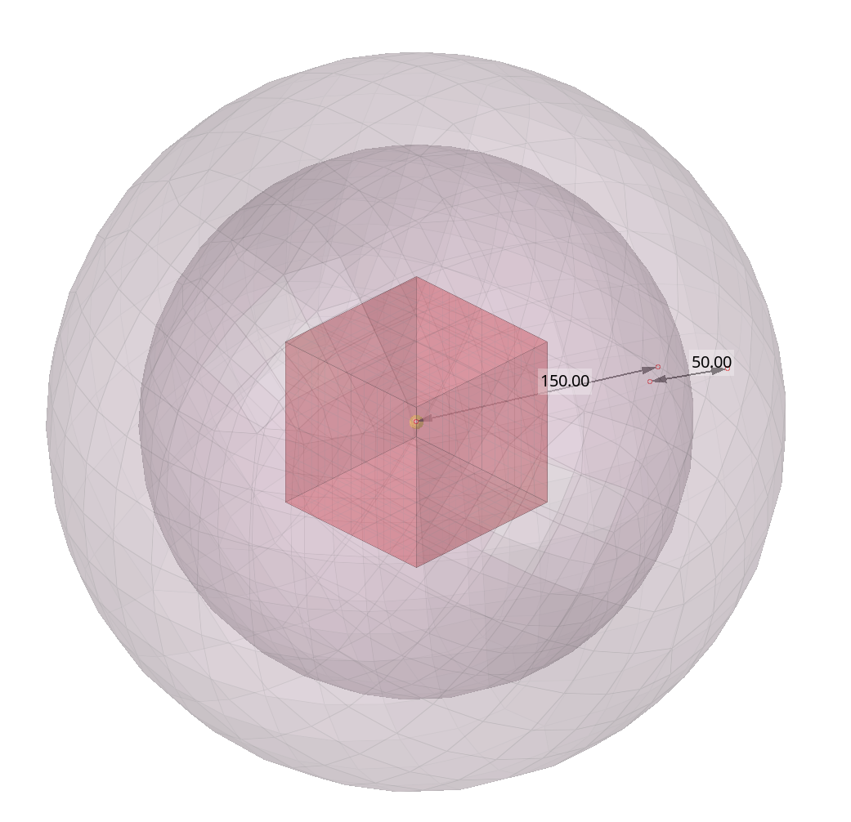
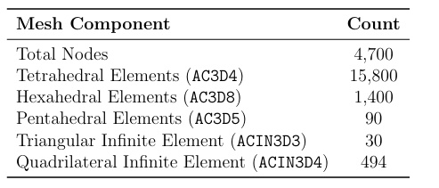
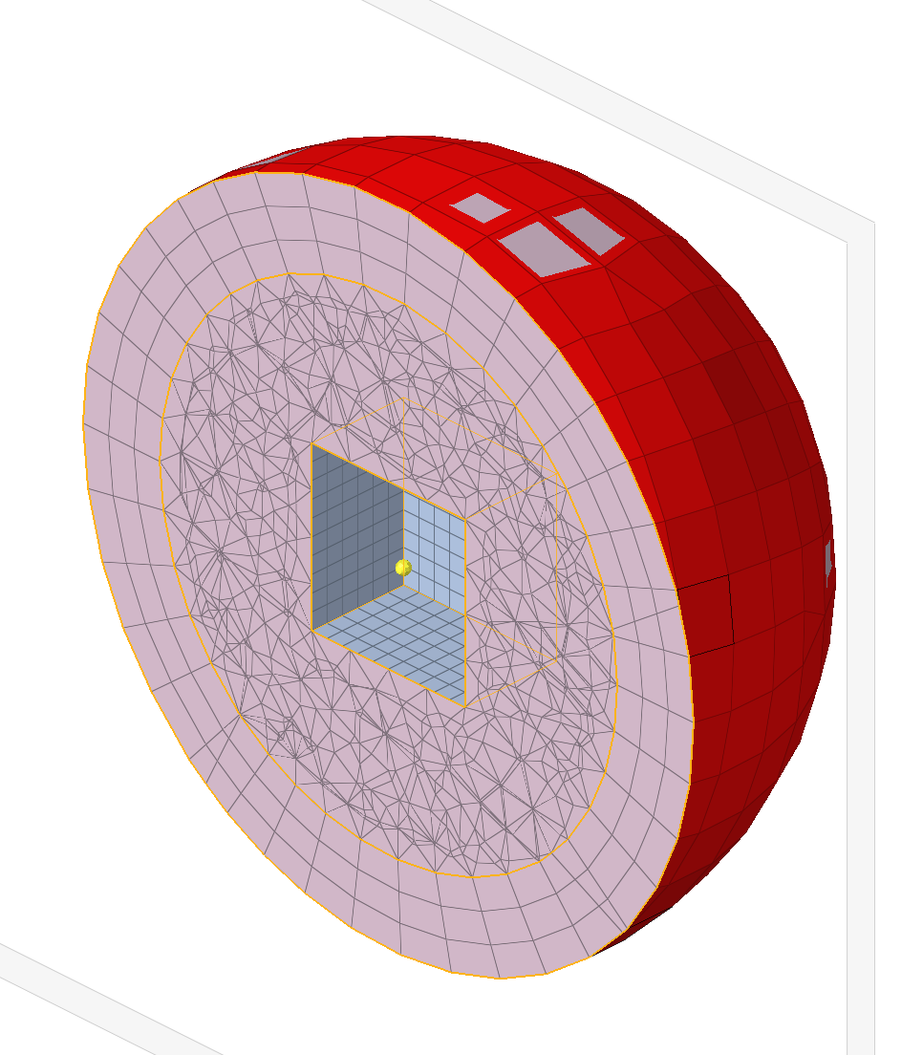
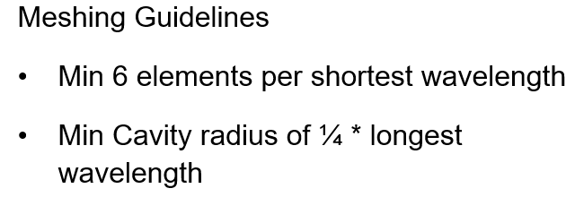
Prototype Cube Model
Model of a 100 mm steel cube at the center with a 10 mm element size, surrounded by inner and outer acoustic cavities (air) with a 25 mm element size.
Model showing the inner region meshed with tetra
elements and the outer region meshed with hexa
elements and the Infinite elements in red

Slide 7
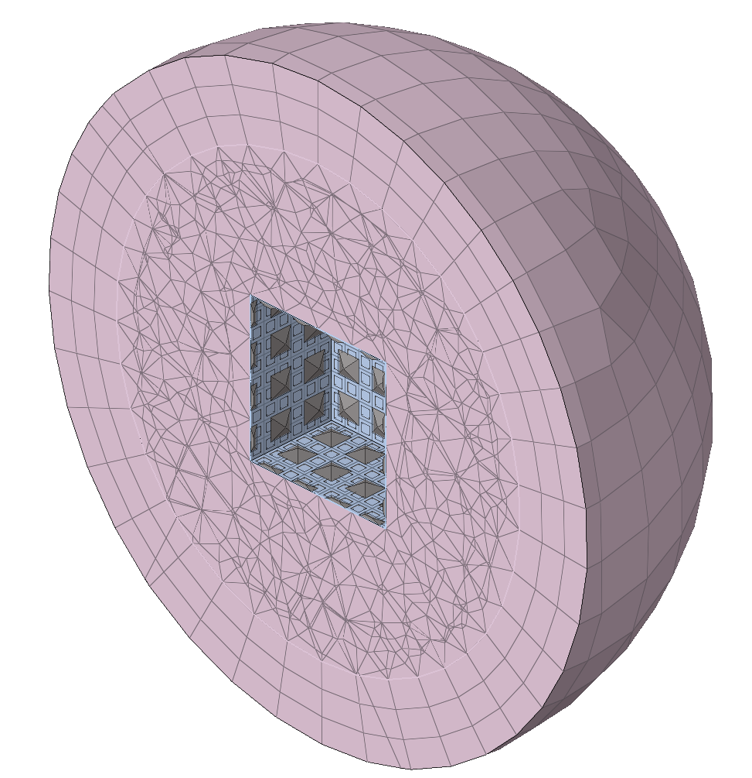

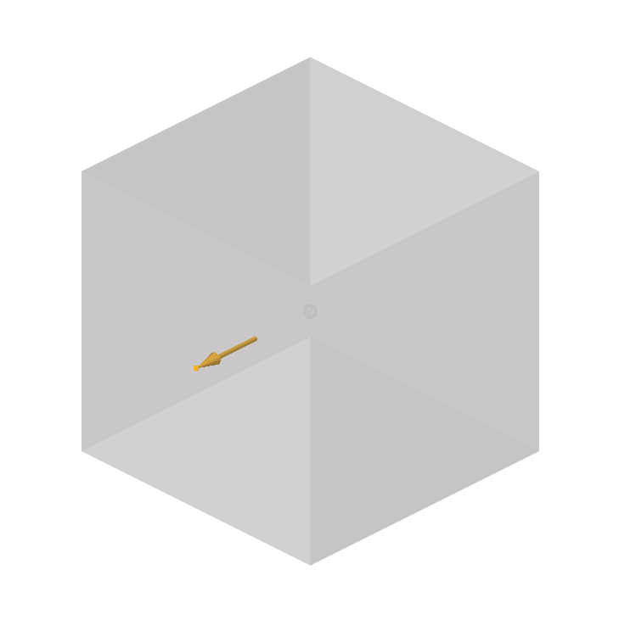
Fully Coupled Structural-Acoustic Analysis
Analysis Type: Direct-solution steady-state (SSD) dynamic analysis.
Frequency Sweep: 500 Hz to 1000 Hz with a 10 Hz step.
Loading Condition: 100 N harmonic load applied at a single node on the cube surface.
Structural Tie Elements:
Enforce normal velocity continuity and account for acoustic pressure loading on the structure.
An element-based surface is defined on the outer surface of the cube and the innermost layer of the acoustic cavity to define the tie elements.

Slide 8
Sequentially Coupled Structural-Acoustic Analysis
Transfer Velocities
Apply the normal velocity on the acoustic-structural interface ( ASI) elements
01
02
03
Structural Analysis
Perform a Direct SSD on the cube model
Acoustic Analysis
Perform a Direct SSD on the Acoustic cavity model

Slide 9
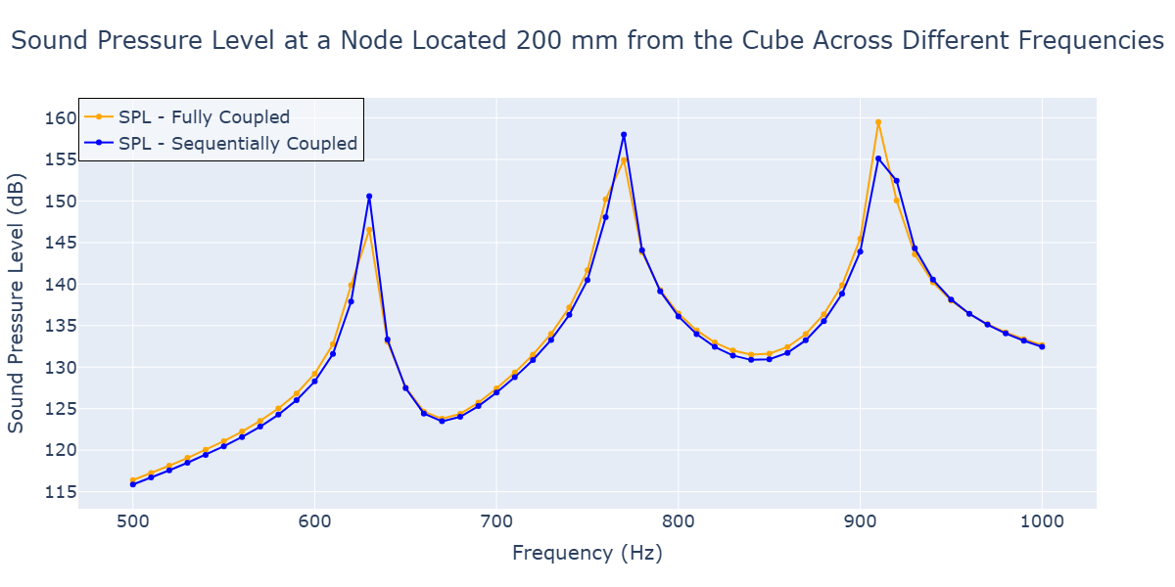
Comparison of SPL results

Slide 10
Comparison of the wall-clock Time
Acoustic Analysis
Structural Analysis

Slide 11
Objective 2: To develop a sequential coupled simulation methodology for a wind turbine gearbox by integrating time-domain displacement data from Simpack into Abaqus

Slide 12
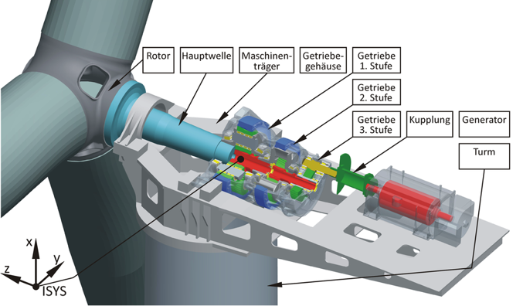
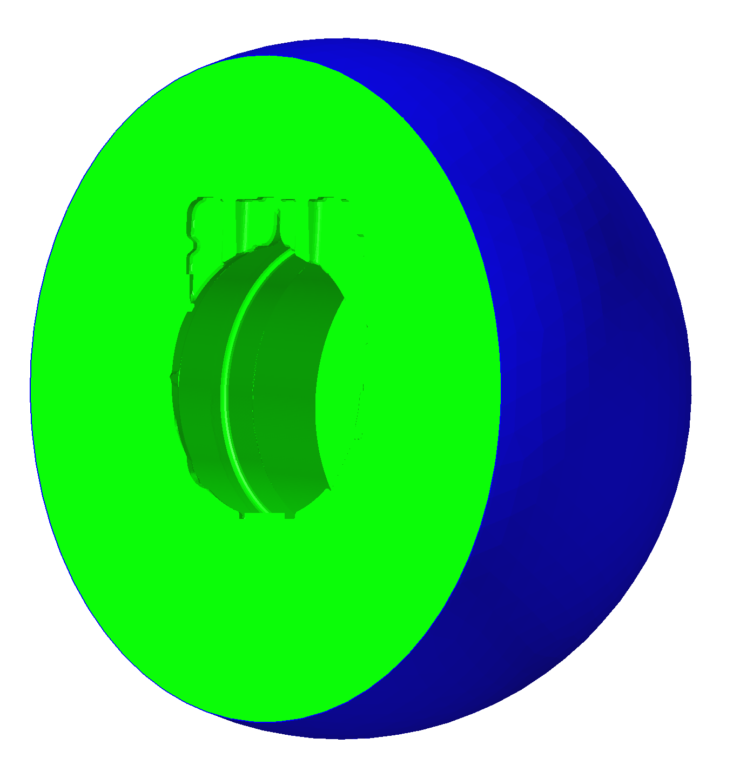
Gearbox Acoustics
Schematic of a typical horizontal-axis wind turbine (Source: Chair of Machine Elements, TU Dresden)
Sectional view of the 215 mm acoustic cavity tetra mesh, highlighting the infinite elements (blue) at the outermost 2300 mm boundary.

Slide 13
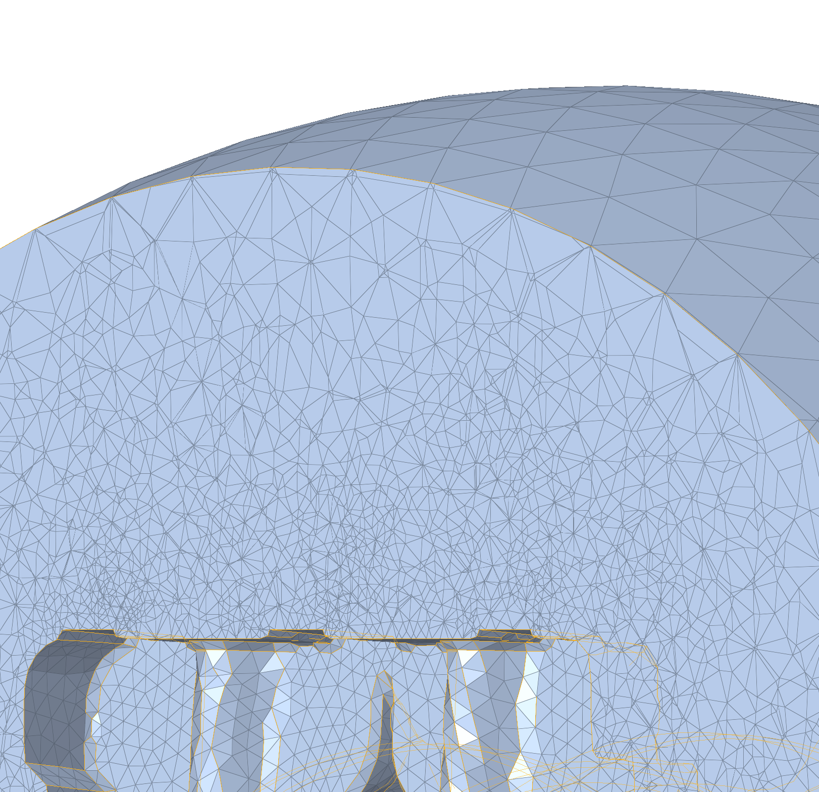
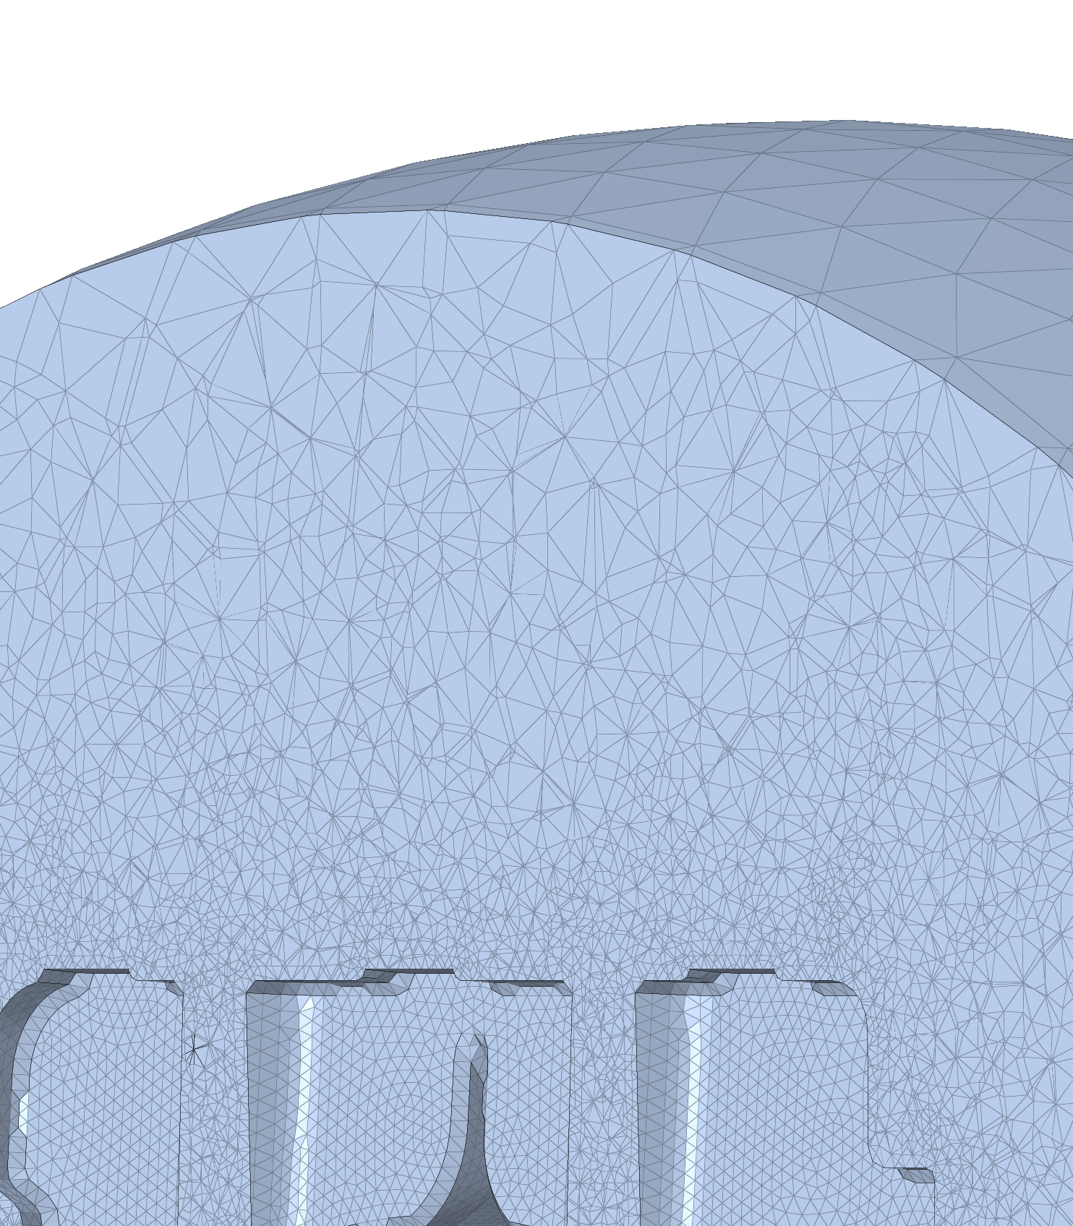
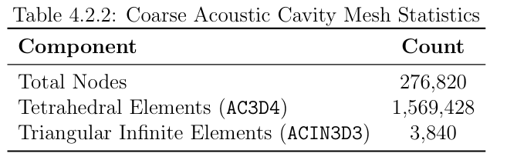
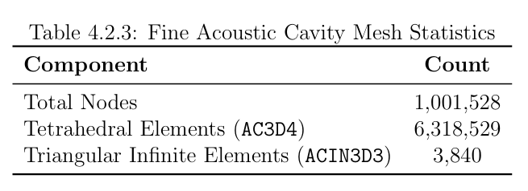
Mesh and Interface Sensitivity Study
Cross-sectional view of coarse acoustic cavity mesh.
Created by a 50mm wrapper gearbox mesh.
Structural-Ties are used as interface elements.
Cross-sectional view of fine acoustic cavity mesh.
Created by a 10mm gearbox mesh.
ASI elements are used as interface elements.

Slide 14
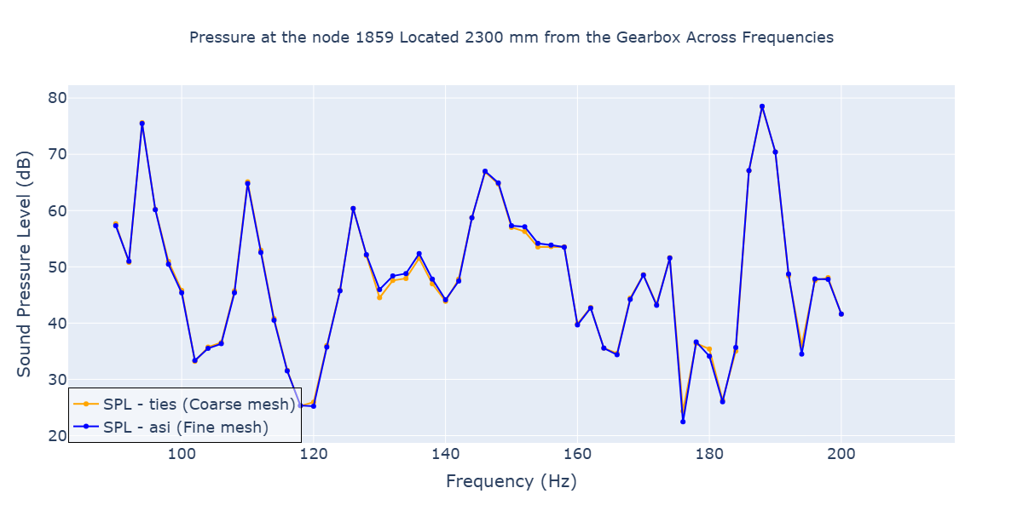
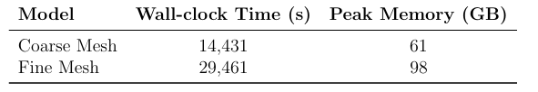
Comparison of SPL results

Slide 15
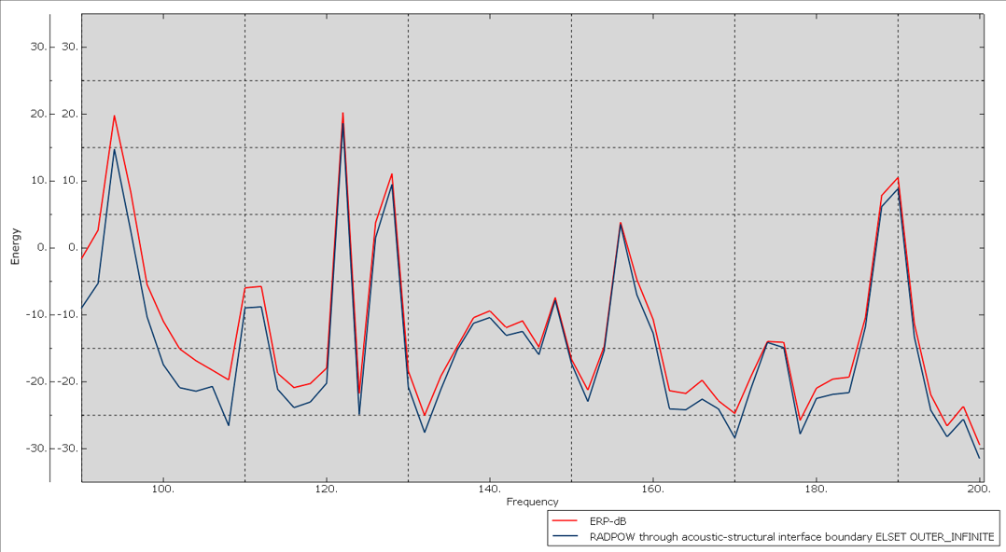
Comparison of Sound Power results

Slide 16
Objective 3: To validate acoustic simulations in BEMPP by comparing SPL predictions with Abaqus results for the prototype cube model.

Slide 17
Comparison between FEM and BEM
Finite Element Method (FEM) | Boundary Element Method (BEM)
Entire Acoustic cavity volume is discretized | Only the boundary is discretized
No prior knowledge of the fundamental solution is required | Requires a fundamental solution to the PDE for formulation
Results in a large, sparse matrix of the form K u = F | Leads to a small, dense matrix of the form H u = G q
Suitable for finite domains | Suitable for infinite or semi-infinite domains
Approximates the solution and its derivative must be computed separately | Directly approximates both solution and its derivative
Easily handles nonlinear and inhomogeneous problems | More challenging to apply to nonlinear or inhomogeneous problems
Fields: Structural mechanics, heat transfer | Fields: Acoustics, electrostatics

Slide 18
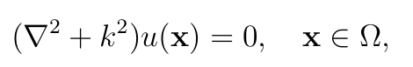
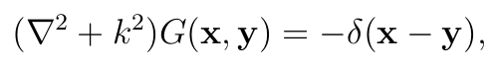
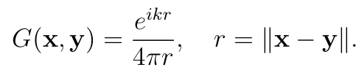
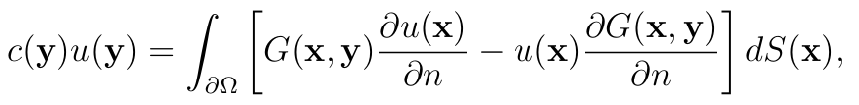
Direct BEM Formulation for the Helmholtz Equation
Governing equation of harmonic sound wave propagation:
Green’s function is the solution to the fundamental solution:
3D free space Green’s function:
Boundary Integral Equation:

Slide 19
Sequentially Coupled Structural-Acoustic Analysis in BEMPP
Perform Structural Analysis
conduct a Direct SSD on the cube model in Abaqus
Set Up BEMPP Model
Import the cube model and outer layer of acoustic cavity model
Compute Far-Field SPL
Compute the SPL on the outer sphere using the pressure and velocity field on the boundary of the structure
01
02
03
04
05
Extract Normal Velocities
Extract Normal velocities of the structure nodes over operating frequencies as a numpy array
Acoustic Analysis
Solve the boundary integral equation using GMRES to obtain pressure field on the boundary of the structure

Slide 20
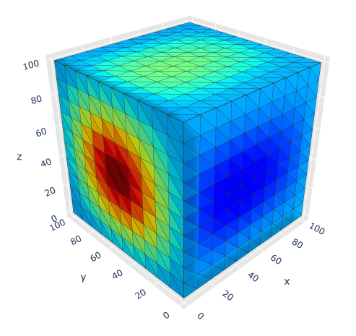
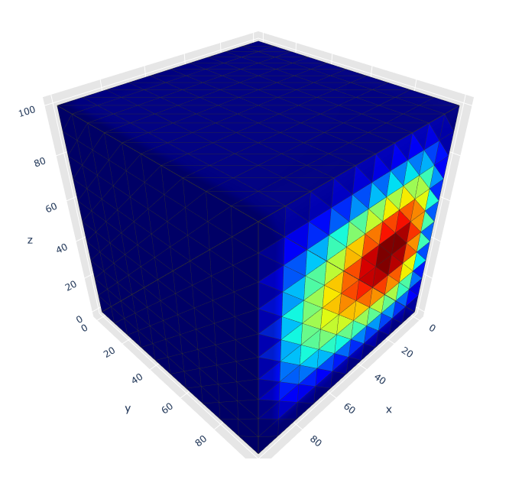
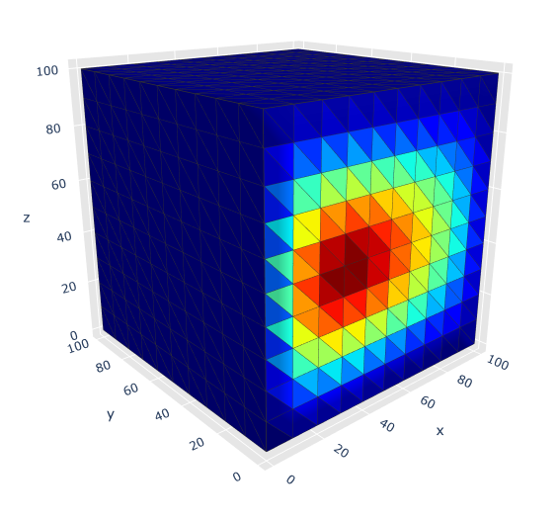
BEMPP Acoustics
Velocity loaded to the single face
perpendicular to the y-axis
Velocity loaded to the two faces perpendicular to the y axis
Velocity loaded to all faces of the cube

Slide 21
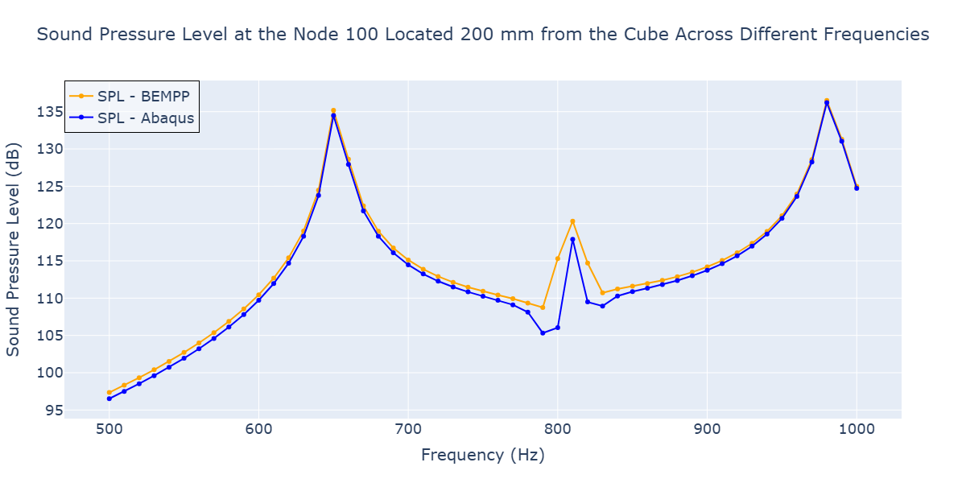
Comparison of SPL results

Slide 22
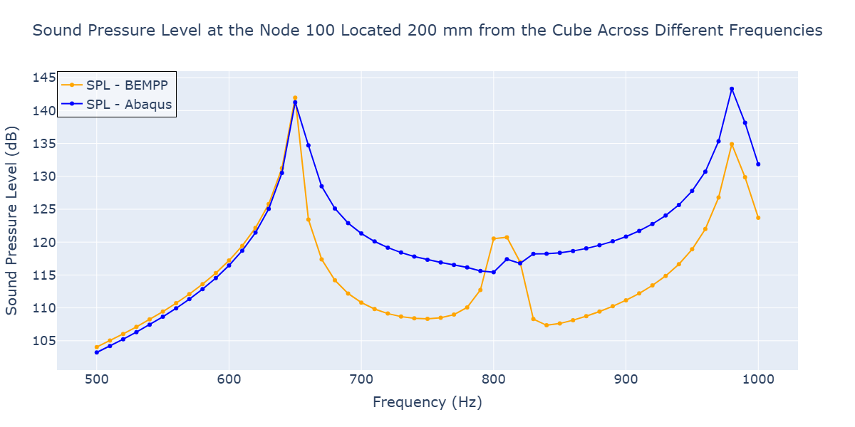
Comparison of SPL results

Slide 23
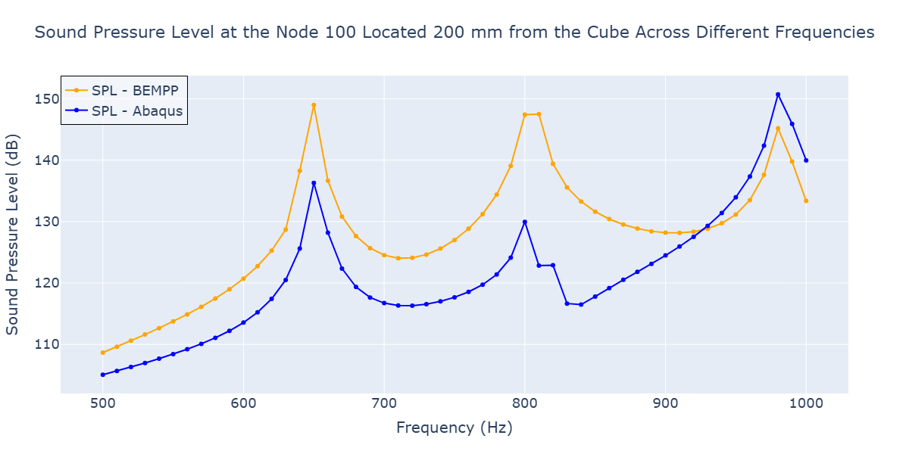
Comparison of SPL results

Slide 24
Possible Reasons for the Discrepancies Between BEMPP and Abaqus Results
Mesh Resolution vs Wavenumber
Higher frequencies increase the wavenumber k.
Keeping the mesh size h fixed while increasing k can lead to larger errors because maintaining a constant hk is necessary to preserve the stability and accuracy of the boundary integral operator.
Experiments 2 and 3 show up to 10–18 dB deviation at higher frequencies.
Non-Smooth Geometry
Multiple cube faces meeting at sharp edges create a non-smooth boundary.
Smooth boundary is required for the boundary integral operators to be coercive.

Slide 25
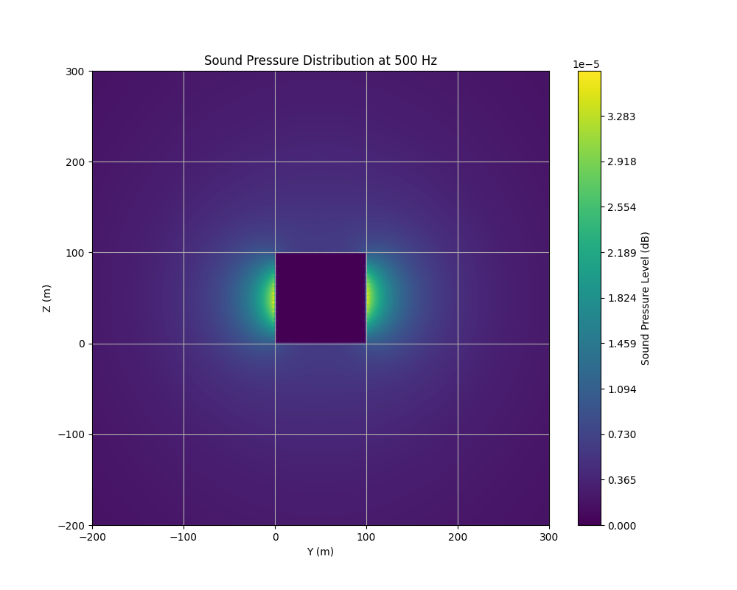
Validation of the Null-Field Approach in BEMPP

Slide 26
Conclusion
Objective 1:
The SPL comparisons indicate that the sequentially coupled approach closely matches the fully coupled analysis.
Sequentially coupled analysis requires less computational time than fully coupled analysis, making it a viable and efficient alternative.
Objective 2:
The time domain velocity data from MBS in Simpack can be used to perform acoustic analysis in Abaqus, thereby the complex gear meshing, bearing interaction can be better accounted in acoustic calculations.
Both Structural Ties and Acoustic-Structural Interface (ASI) elements can be used for coupling, with the choice depending on ease of implementation.
Objective 3:
Good agreement between Abaqus and BEMPP for single-face loading and increasing discrepancies with multiple faces.

Slide 27
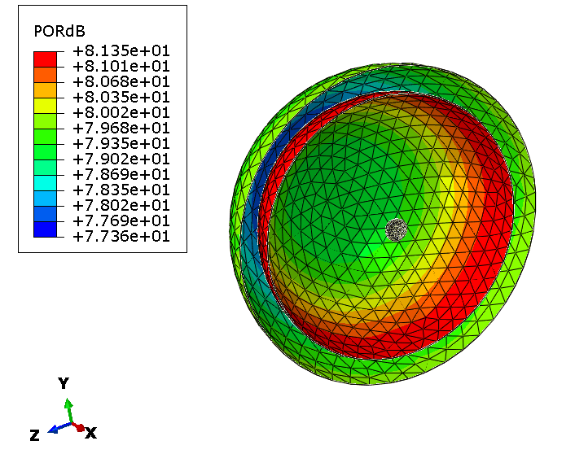
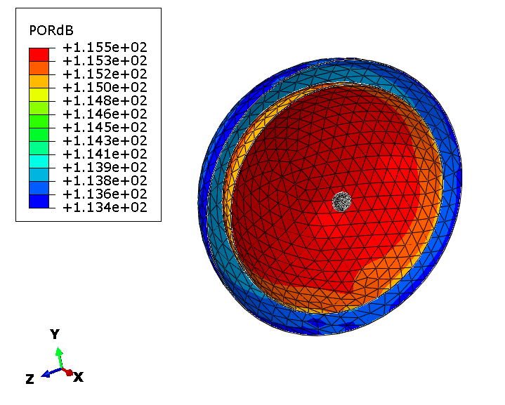
Far Field Visualization
Visualization of SPL at 500Hz in the far field at distances of 2000mm and 2500mm from the cube
Visualization of SPL at 1000Hz in the far field at distances of 2000mm and 2500mm from the cube

Slide 28
Vielen Dank
für Ihre Aufmerksamkeit!

Slide 29
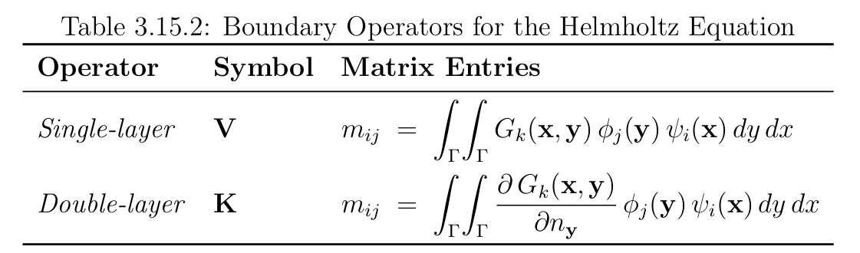
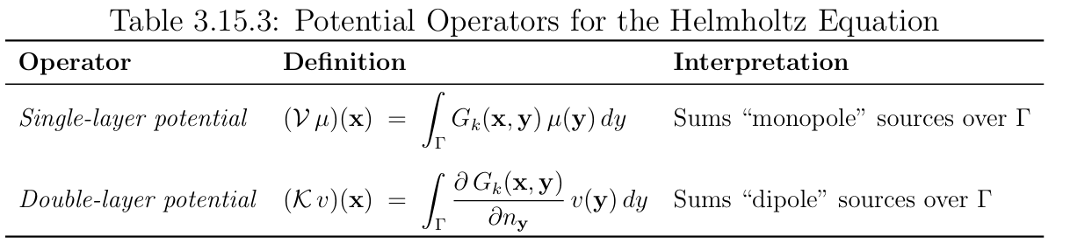
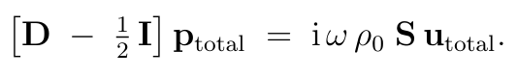

BEM Formulation in BEMPP
Matrix Representation in a Discretized Form:
Sound pressure in the region outside structure’s boundary calculated by the representation formula:

Slide 30
Sequentially Coupled Gearbox Acoustics
Simpack
Conduct a time domain MBS over a range of operating speeds.
Data Conversion
Convert data into Abaqus boundary condition-compatible format using Python scripts.
01
02
03
04
Disp/velocity Data
Extract gearbox casing node displacements at operating frequencies after reaching steady state.
Acoustic Analysis
Conduct a direct SSD on the gearbox acoustic cavity model from 80 hz to 200 hz

Slide 31
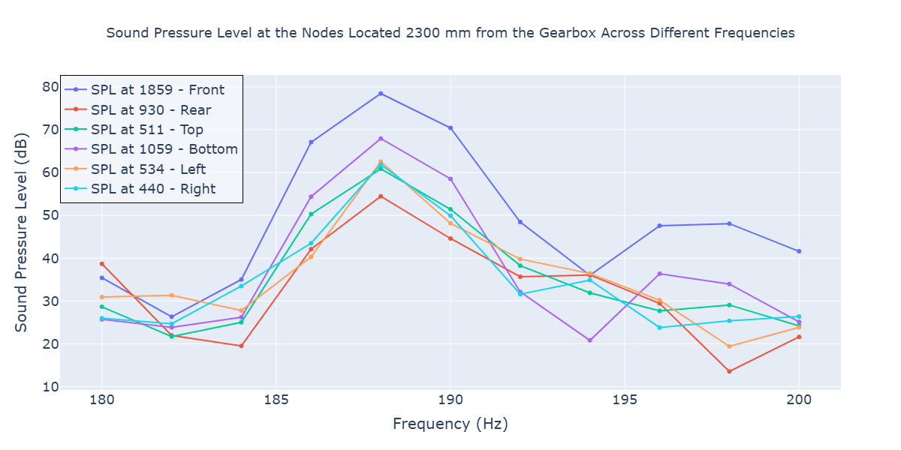
Comparison of SPL results

Slide 32
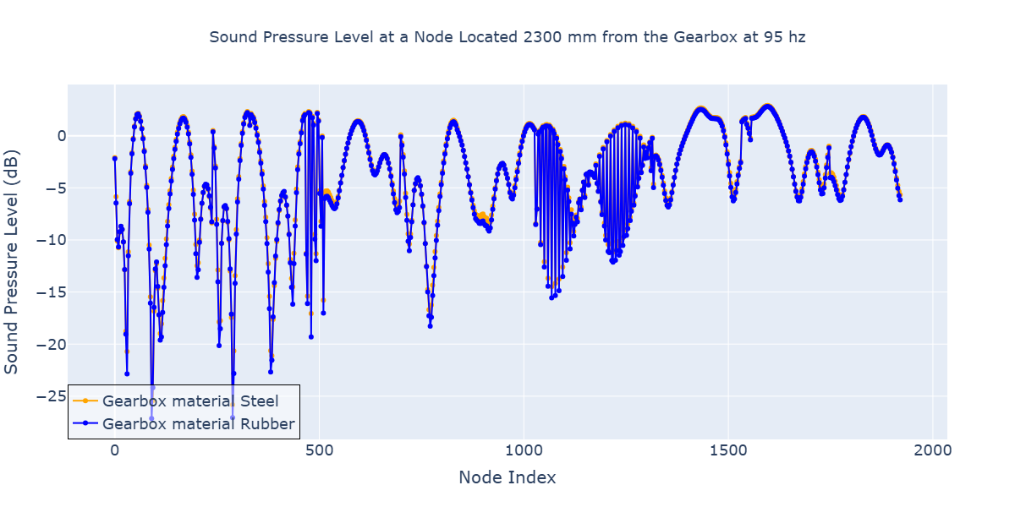
Comparison of SPL results

